Slide 1
Distributed optimization using ADMM
A general approach for decomposing multi-stage NLP
Norwegian University of Science and Technology

Slide 2
ADMM – Quick Theory

Slide 3
ADMM for consensus
ADMM for consensus problems (Ch 7, Boyd 2010)
(Boyd 2010) - Distributed Optimization and statistical learning via the Alternating Direction Method of Multipliers,

Slide 4
Decomposing a two-stage NLP – previous work

Slide 5
Decomposing in a general fashion using ADMM

Slide 6
A simple mixing tank model for TES
Has a trivial solution for optimal operation
Design Decision
Volume of the Tank (V^{tes})
Area of the Heat exchanger (A^{whb})
Operations d.o.f – (red in fig)
Differential states
T^{tes}
T^{phb}
T^{whb}_{1-nCell}

Slide 7
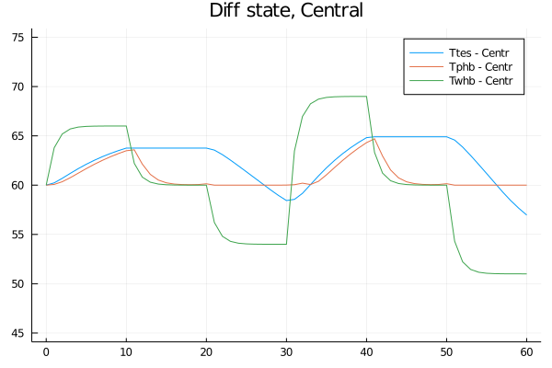
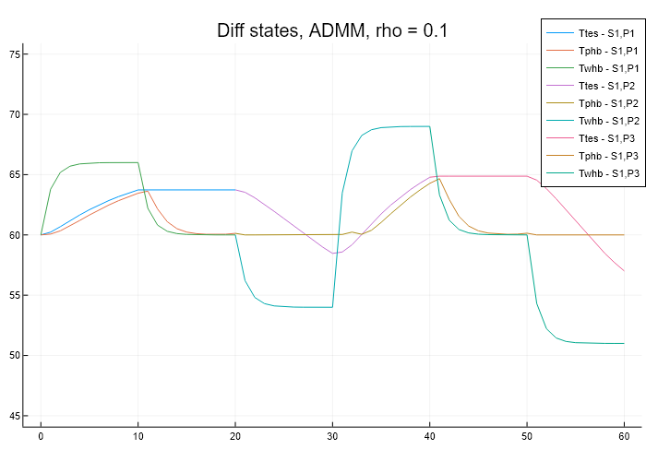
Example - SX1,PX3
Converges to same local solution as central approach

Slide 8
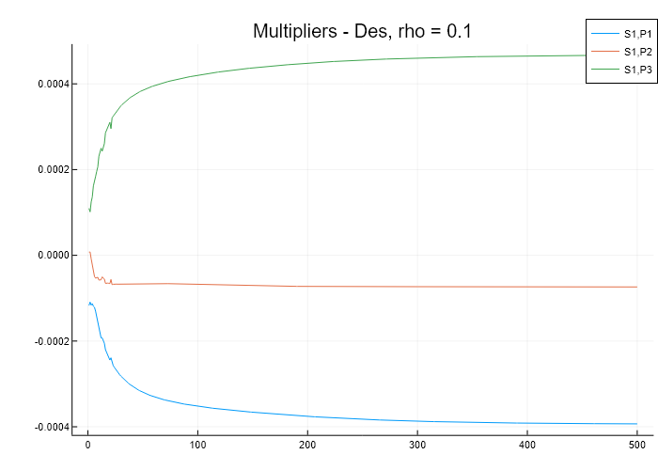
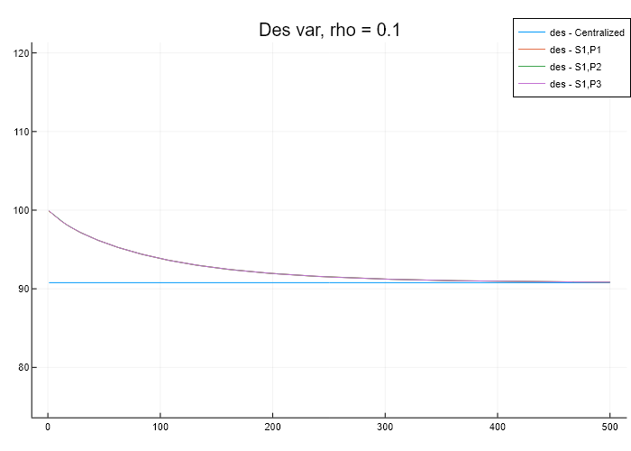
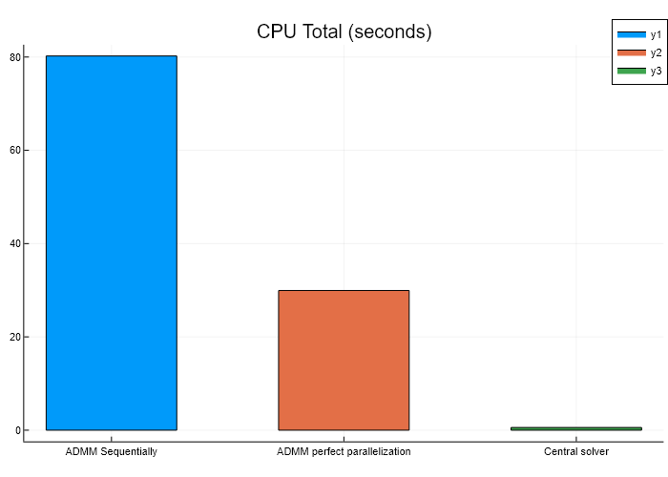
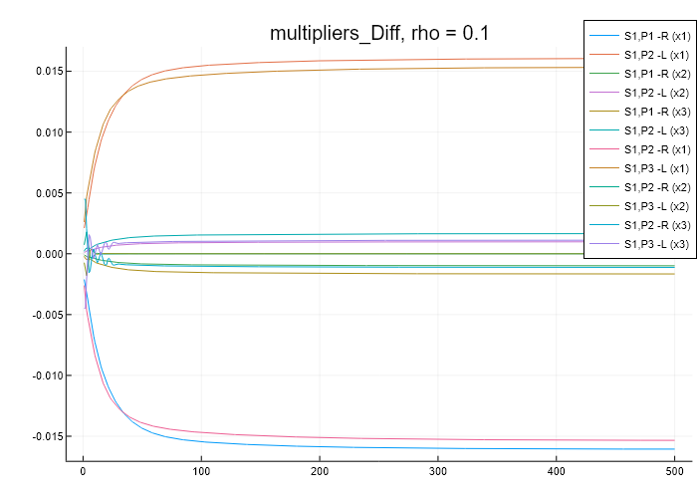
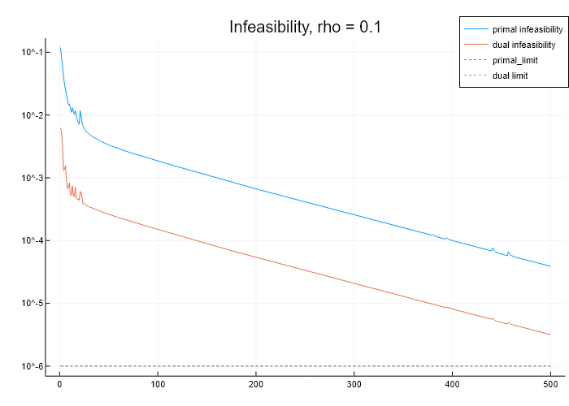
ADMM Convergence
Design variable very slow to converge, but able to find same solution
Multipliers in different orders of magnitudes
Des – 4e-4
Differential – 1e-2 (start temp in partitions)

Slide 9
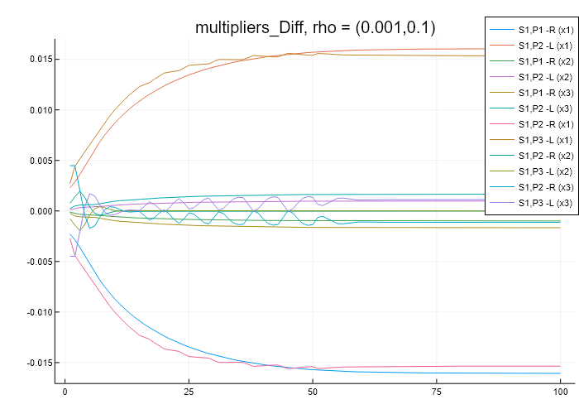
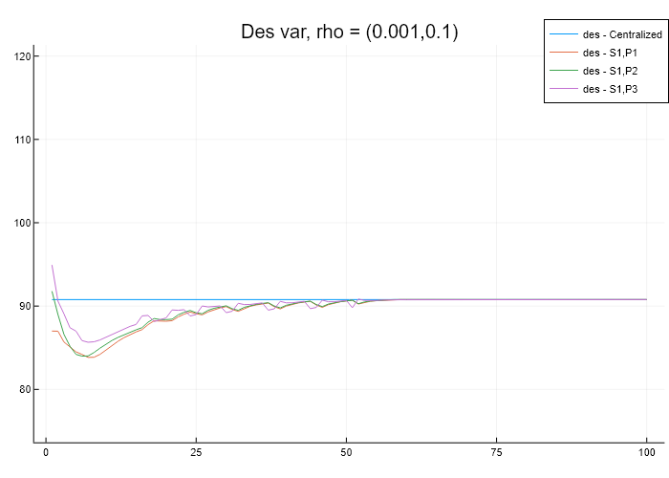
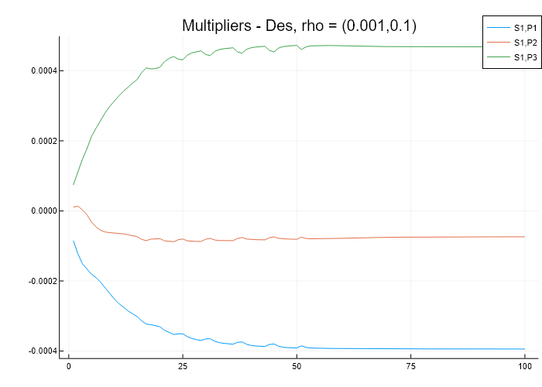
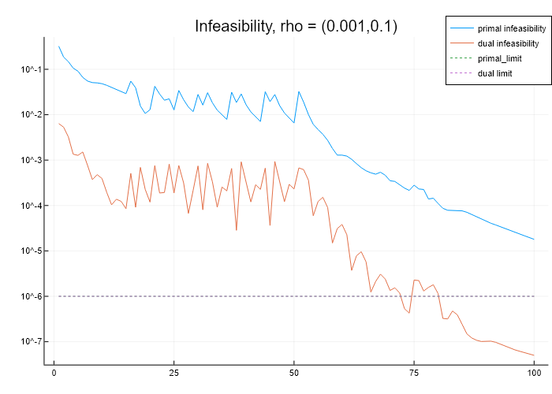
2 rho’s
Convergence tuned to be much faster
According to lagrange multiplier magnitudes

Slide 10
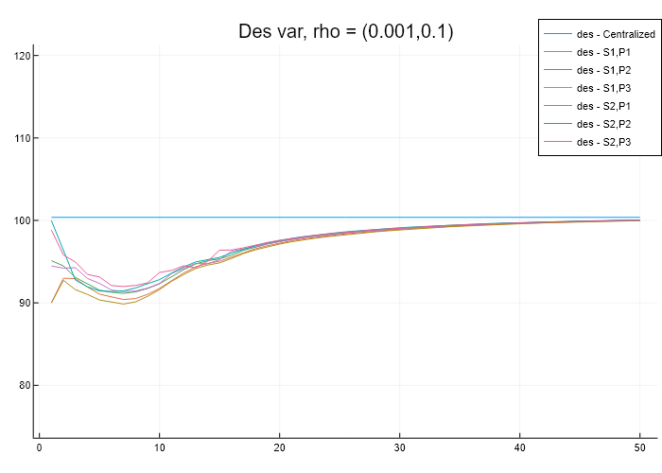
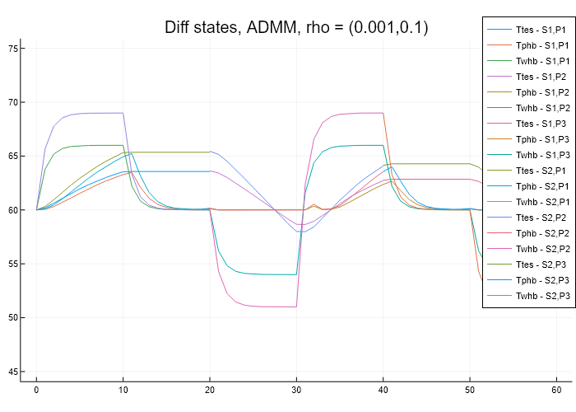
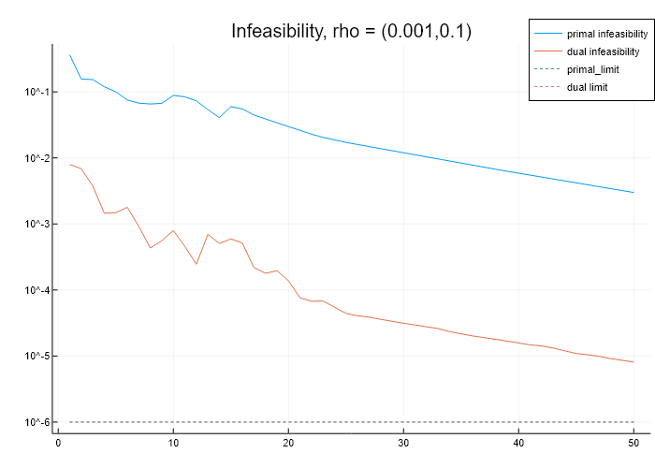
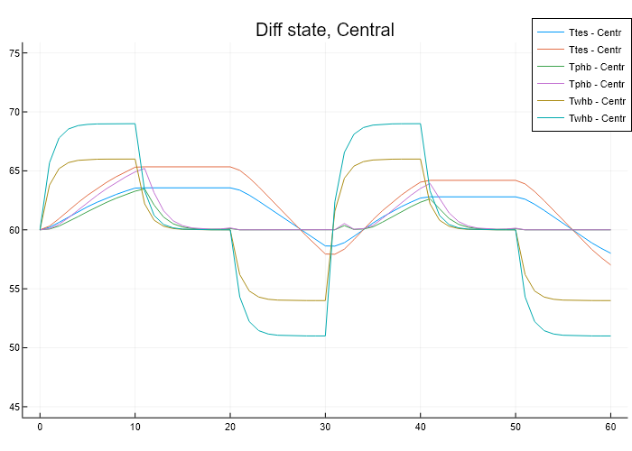
Example – SX2,PX3
Converges fairly fast (around 50 iters)

Slide 11
BACKUP SLIDES

Slide 12
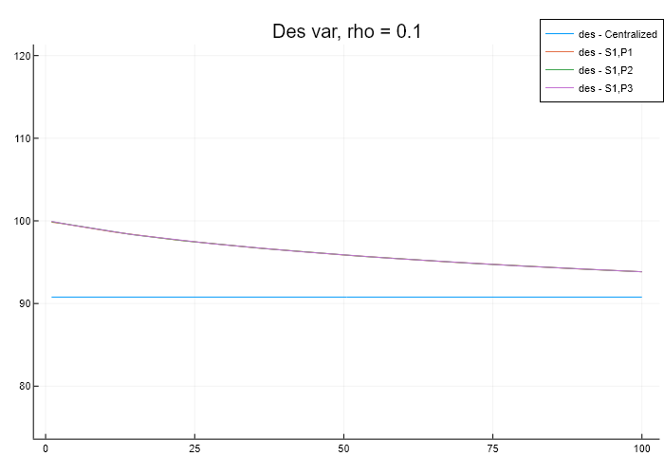
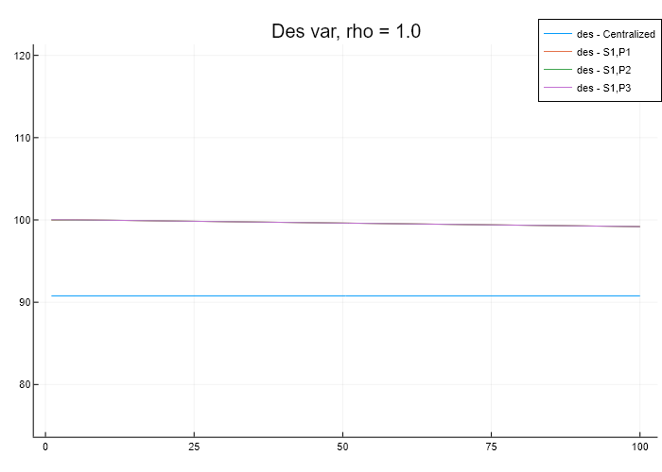
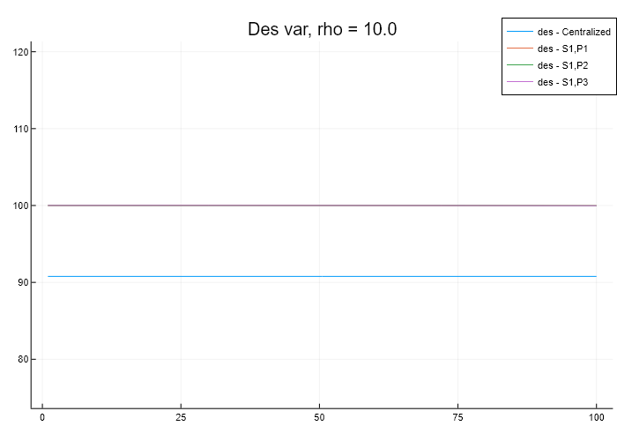
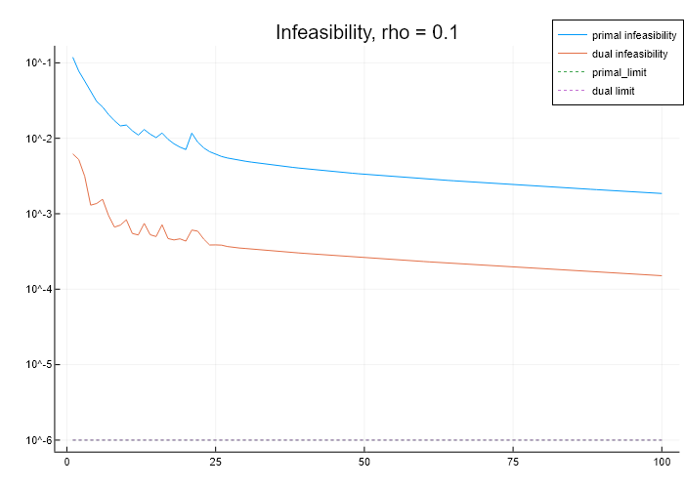
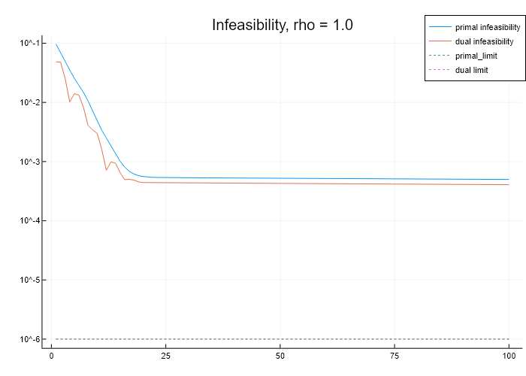
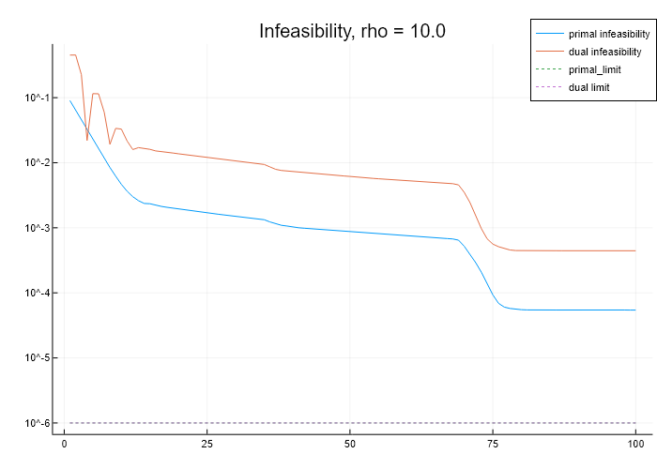
Varying rho (1e-1 to +1)
Sx2,Px3 case. 100 iterations

Slide 13
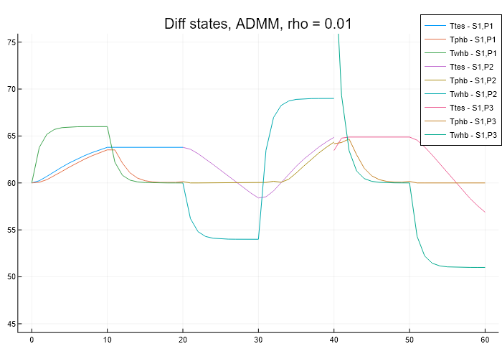
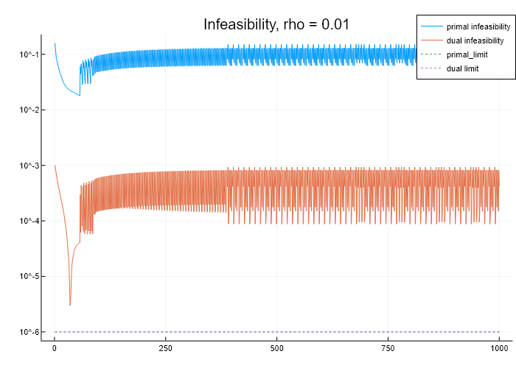
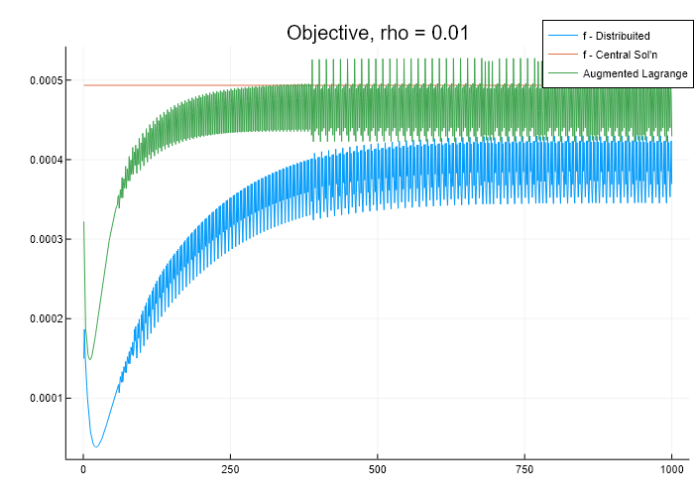
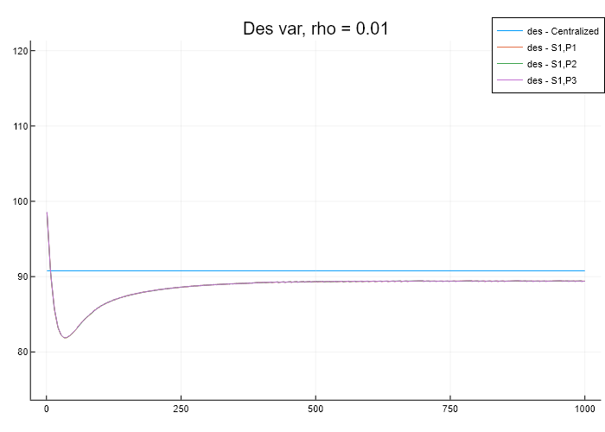
Too low rho (rho = 0.01)
Not converging even after 1000 iterations

